Slide 1
AI Chatbot
Prepared by:
MD SAMI UL ISLAM 12201033
SHEAKH fahim ahMmed joy 12201047

Slide 2
FEATURES
Supervised Learning
Classification Learning
Natural Language Processing, Deep Learning

Slide 3
Steps
Download Dataset
Create a Model
Train the Model
Test the Model

Slide 4
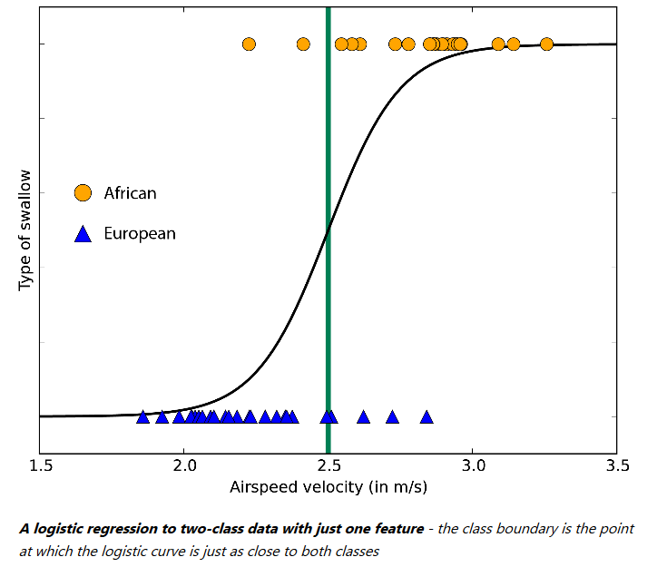
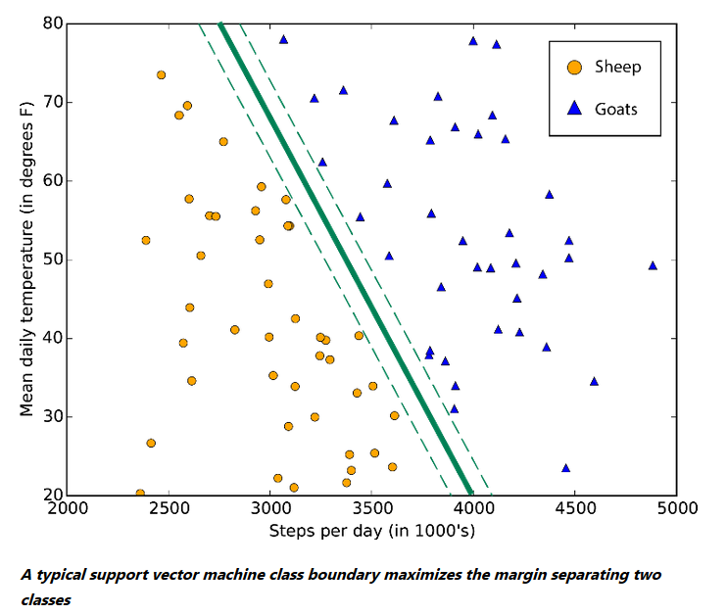
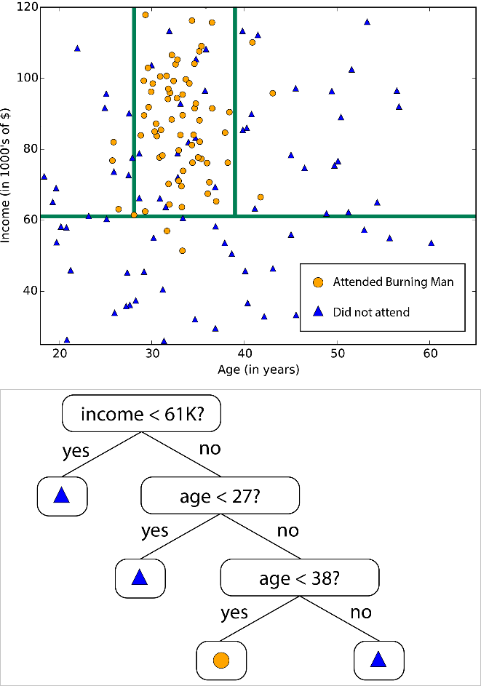
ALGORITHMS
Options: Linear Regression, SVM, KNN, Decision Tree, Neural Network
We Prefer: Logistic Regression, Support Vector Machine, Decision Tree

Slide 5
LIBRARY
taken from Github
had our research
all over the Internet
Opensource AI Chatbot in
Python using Scikit-learn,
NLTK and CRFSuite

Slide 6
EXAMPLE

Slide 7
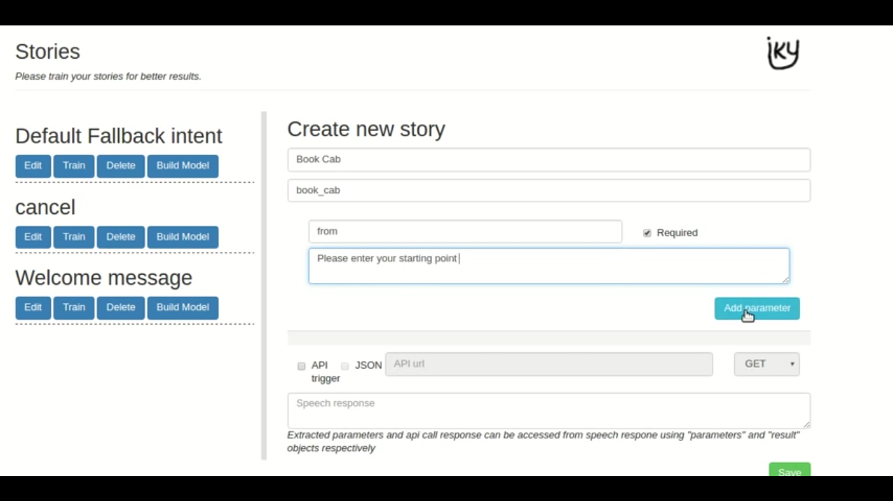

Slide 8
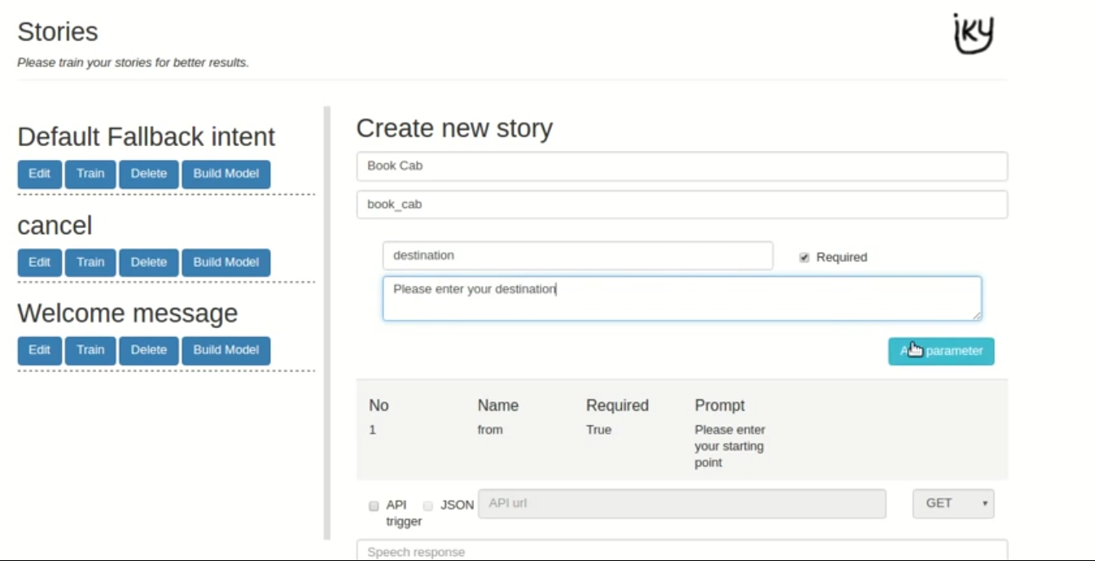

Slide 9
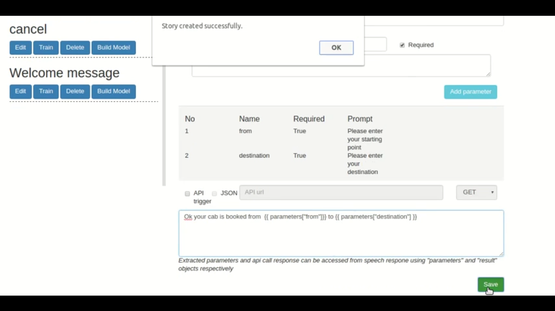

Slide 10
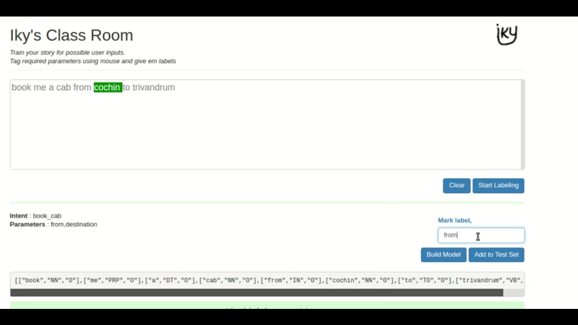

Slide 11
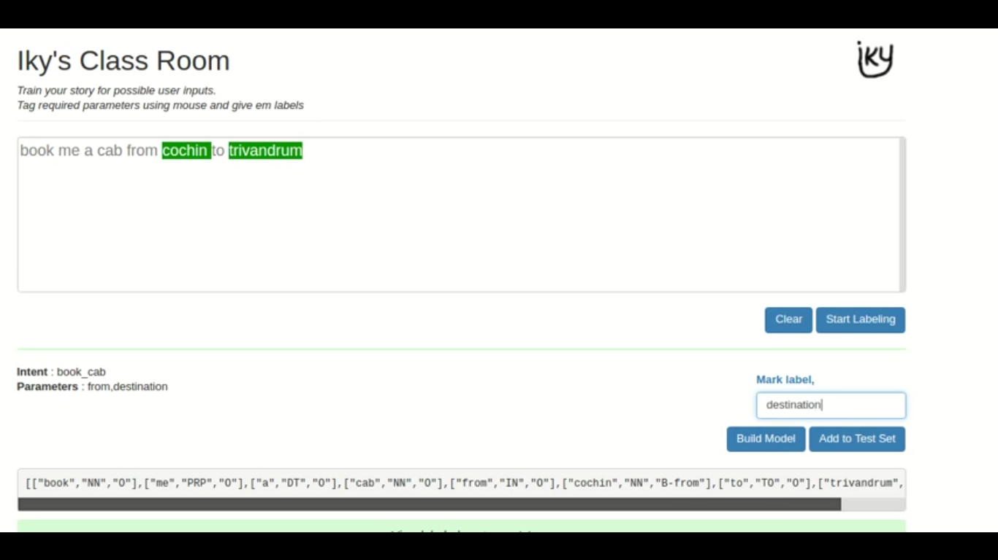

Slide 12
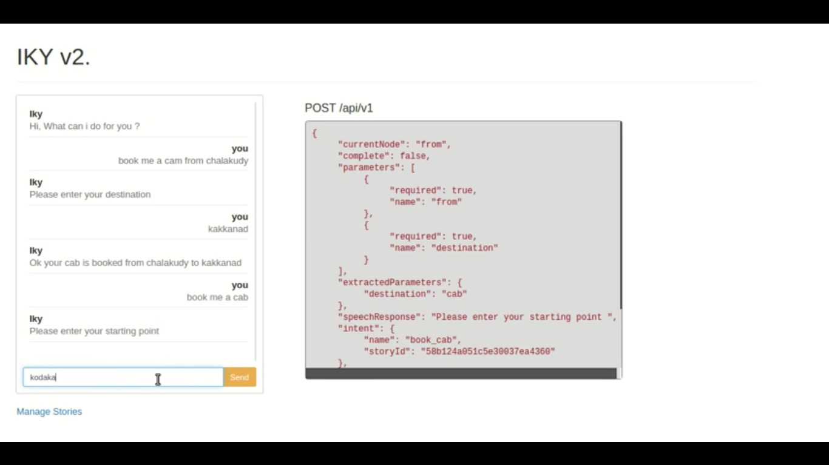

Slide 13
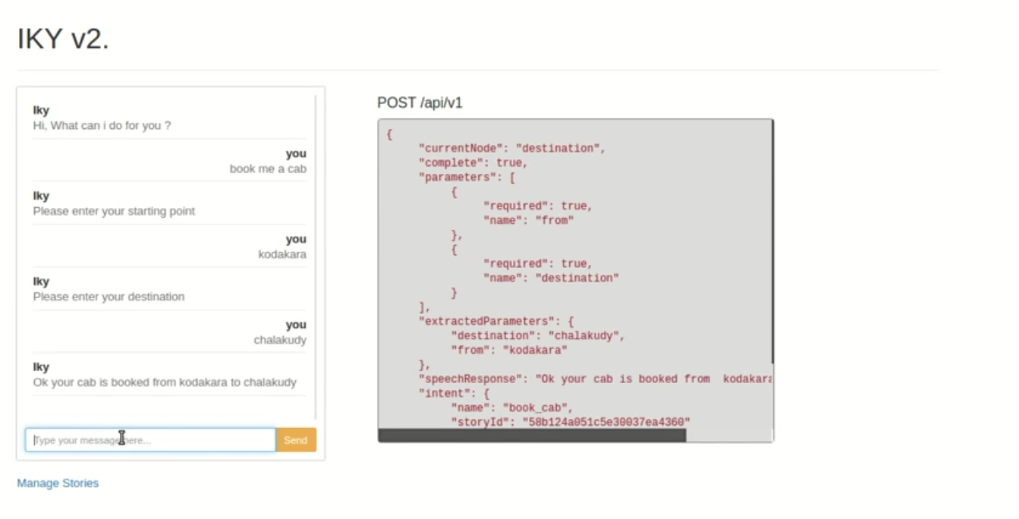

Slide 14
REFERENCES
Idea: seminars, articles
Dataset: Reddit
Code: Github
Tutorial: Siraj Raval, Sentdex, Alfred Francis (YouTube channels)

Slide 15
Revised Model
Finally, we implemented “Beam Search” as the algorithm
It is a restricted or modified version of either a breadth-first search or a best-first search
we discovered Beam Search decoding algorithms that can be used on text generation problems.
In NLP tasks such as caption generation, text summarization, and machine translation, the prediction required is a sequence of words.

